Slide 1
Cyber Security for Machine Learning
Cyber Security in the Development, Operation and Use of Machine Learning Models
Manuel Pasieka , 2. June 2022

Slide 2
Machine Learning Security
Methods and Strategies to attack Machine Learning Models
Manuel Pasieka , 2. June 2022

Slide 3


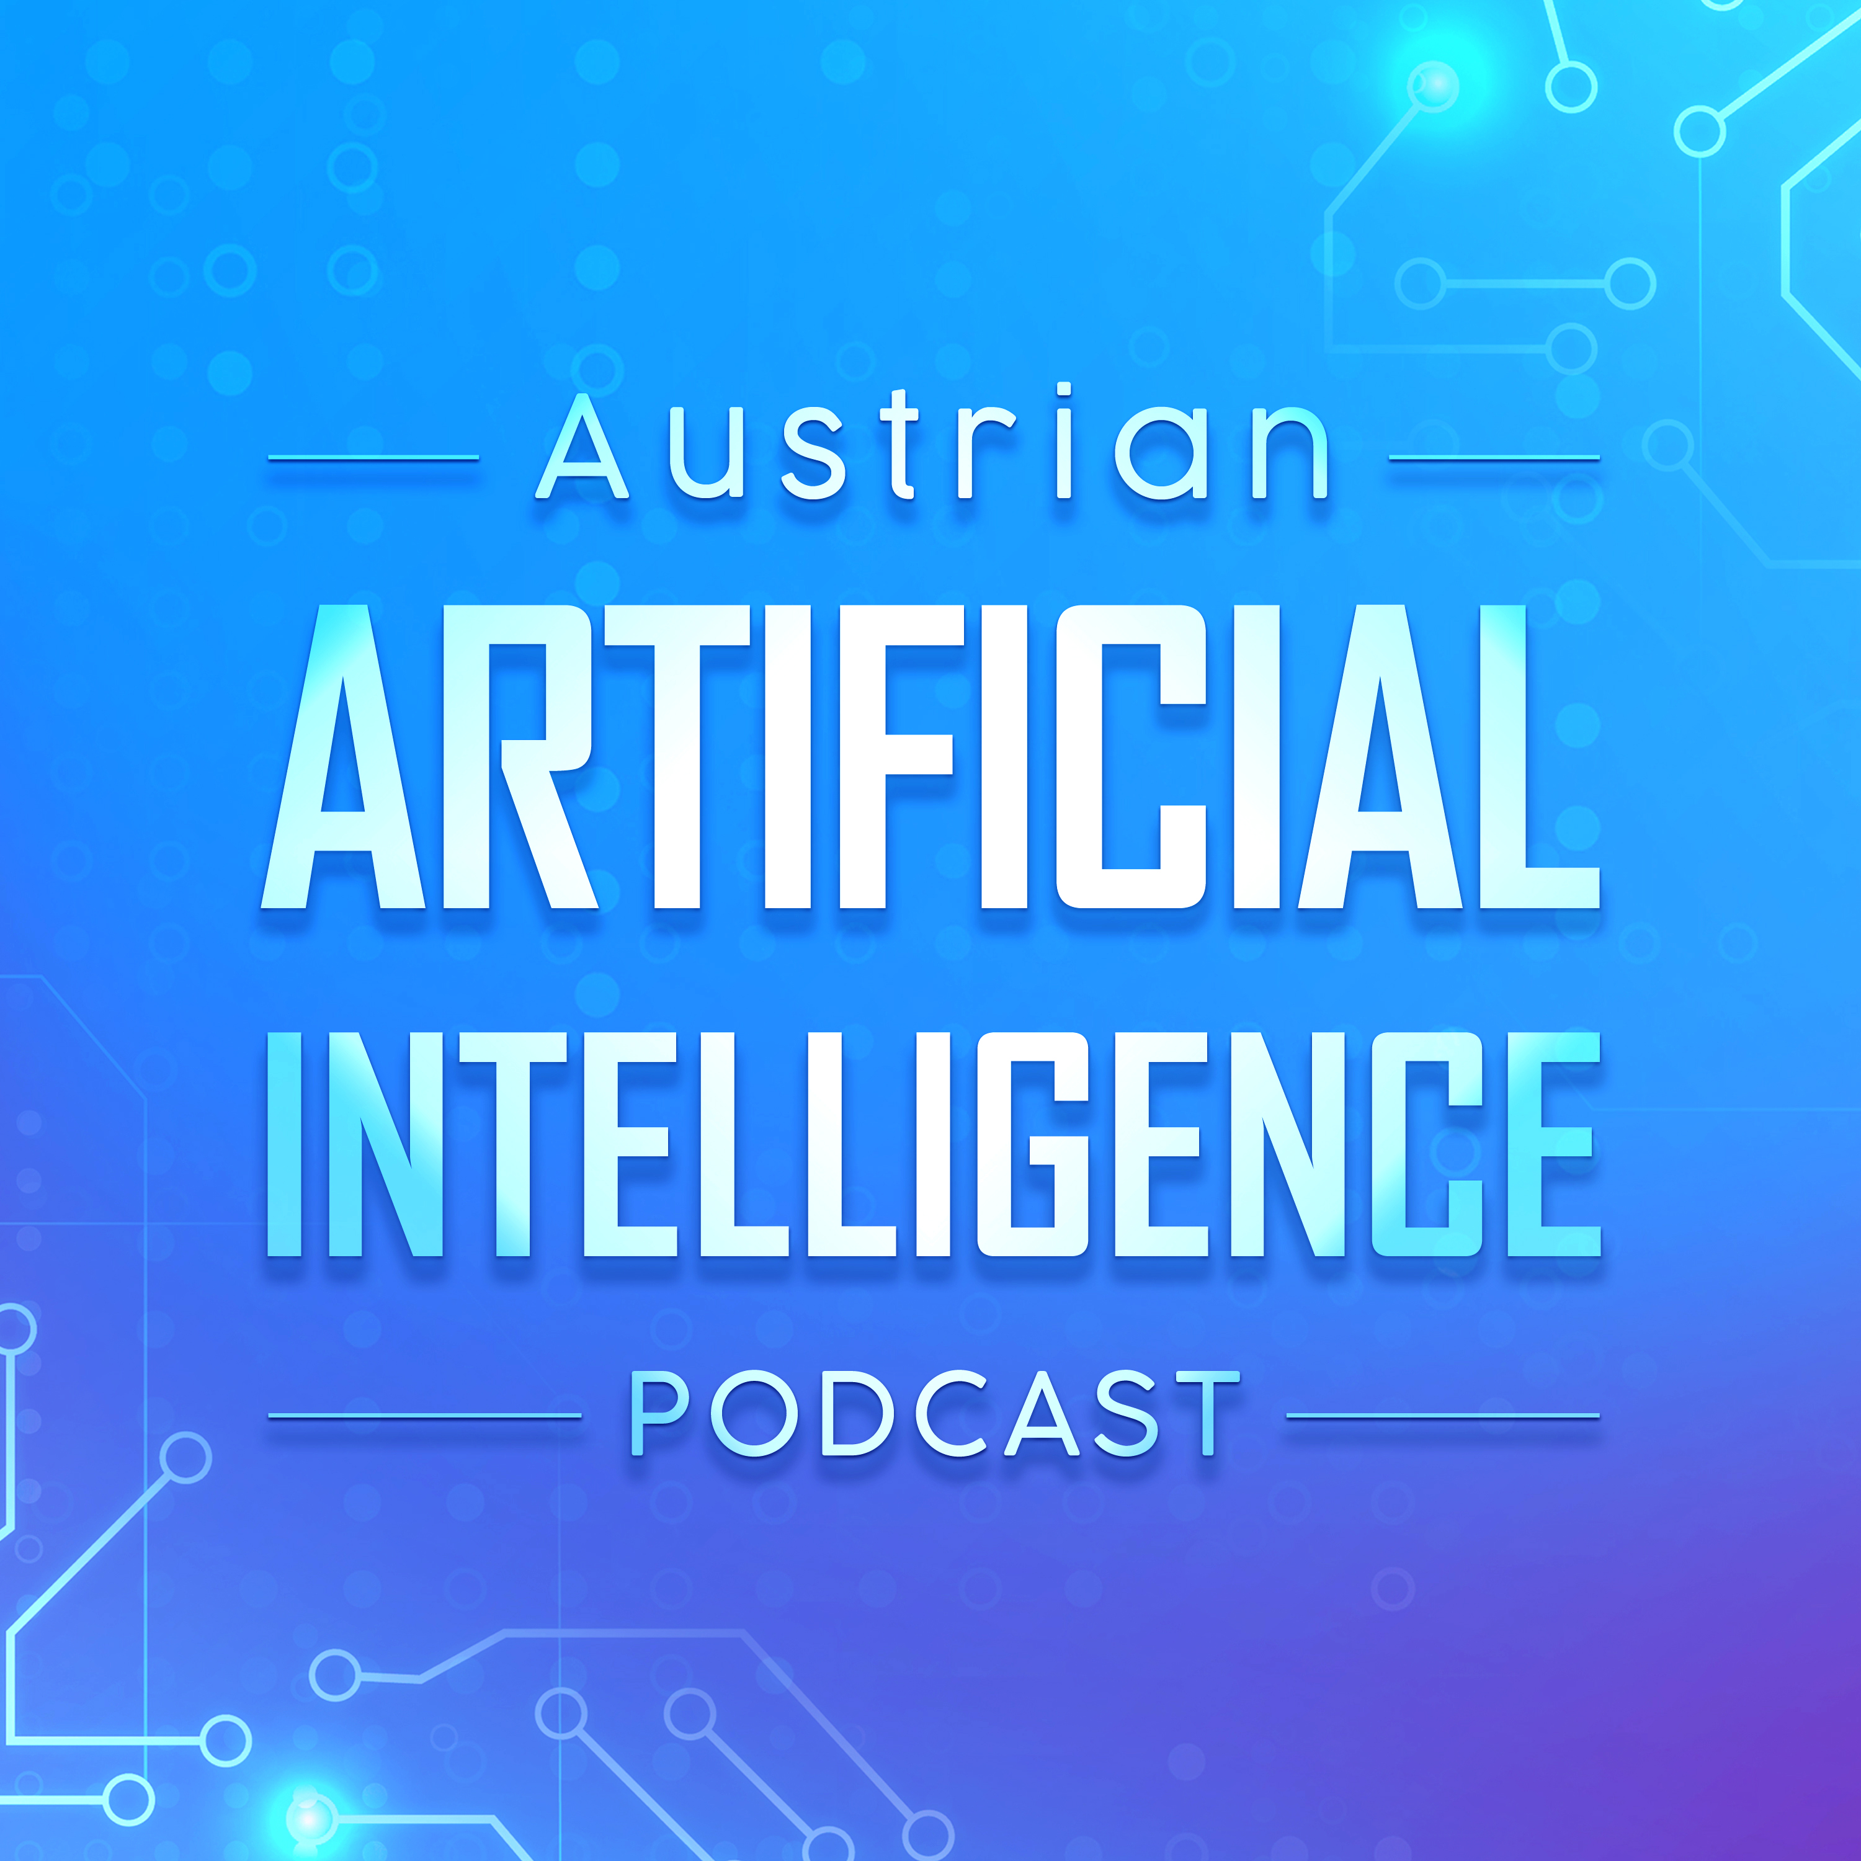
Manuel Pasieka
AI Consultant
Host of the Austrian AI Podcast

Slide 4

What comes to mind?
Cyber security + machine learning

Slide 5
Content
Machine Learning in Cyber Security
Machine Learning Security
DevSecOps / MLSecOps

Slide 6
Content
Machine Learning in Cyber Security
Machine Learning Security
DevSecOps / MLSecOps

Slide 7
Machine Learning Security
MLSec studies the abuse, theft and exploitation of machine learning models.
Attack Surface
Taxonomy & Terminology
Model Extraction / Stealing
Data Extraction
Adversarial Attack
Data Poisoning
Backdoor Attack
Critical System Behavior/Errors
Who cares?
What to do about it?

Slide 8
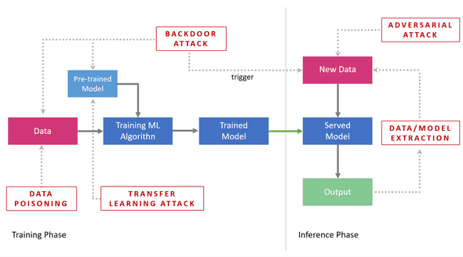

Attack Surface
PLACE HOLDER

Slide 9
Taxonomy and Terminology
Specificity of an attack
Targeted : Affect a single class / user
Indiscriminate : Affect the system as a whole
Influence of an attack
Causative : Affect model training / training data
Exploratory : Affect model inference
System Exposure
black-box : The attack can query the model (API)
white-box : The attack has direct access to the model
Impact on a compromised System (CIA)
Confidentiality : Unauthorized access to data / information
Integrity : System is not operating as designed
Availability : System outage
1. Marco Barreno et al. “Can Machine Learning Be Secure?”, (2006)

Slide 10
Model Extraction / Stealing
10

Slide 11
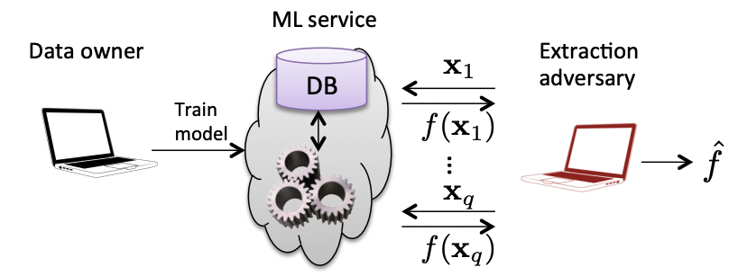
Model Extraction
An attacker users black-box access to the target model to create a substitution/surrogate model infer¹
Architecture
Training hyperparameters
Parameters/Weights
Decision boundaries
Highly dependent on Query efficiency
Create Proxy ML Model (Attack Staging)
Indiscriminate,
Exploratory
black-box,
Confidentiality
Florian Tramèr et al. “Stealing Machine Learning Models via Prediction APIs”, (2016)
1. Oliynyk et al. “I Know What You Trained Last Summer: A Survey on Stealing Machine Learning Models and Defences”, (2021)

Slide 12
Data Extraction
12

Slide 13
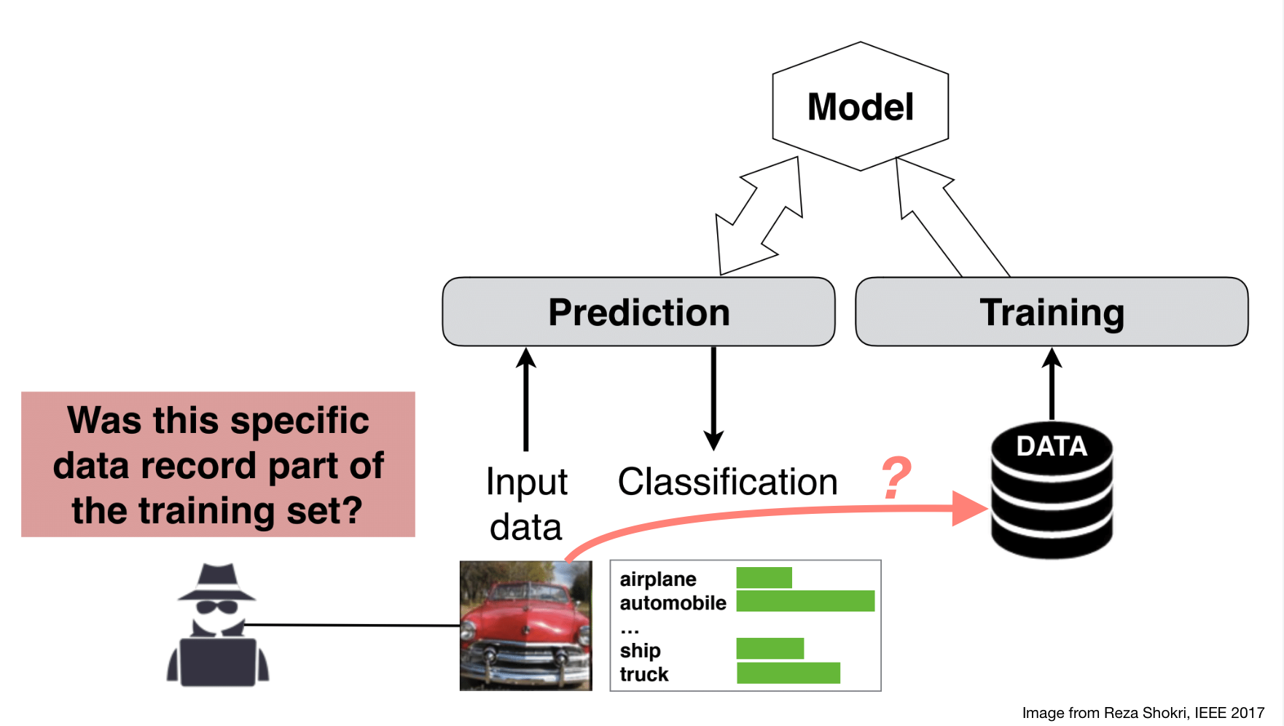
Training Data Extraction
The capability of an attack to infer the presence of individual training records.
Membership Inference Attack¹ is exploiting a model’s tendency to memorize training data, making it possible to infer if a single input record was part of the training set by analyze the confidence of a prediction.
Indiscriminate
Exploratory
Black-box
Confidentiality
Reza Shokri et al., “Membership Inference Attacks Against Machine Learning Models”
1. Hu, Hongsheng, et al. "Membership inference attacks on machine learning: A survey." ACM Computing Surveys (CSUR) (2021).
Notes:
Can be performed against descriptive models (image classification …) as well as against generative models (GAN’s, Language models)
In descriptive cases one studies an ensemble of shadow models and creates a binary classifier (attack model) that learns to identify training datapoints for the shadow models
Source: Overfitting (not traditional overfitting)
Countermeasures: Training with Differentially Private Stochastic Gradient descent (low acc, increased training time), Confidence Score Masking, Regularization,

Slide 14
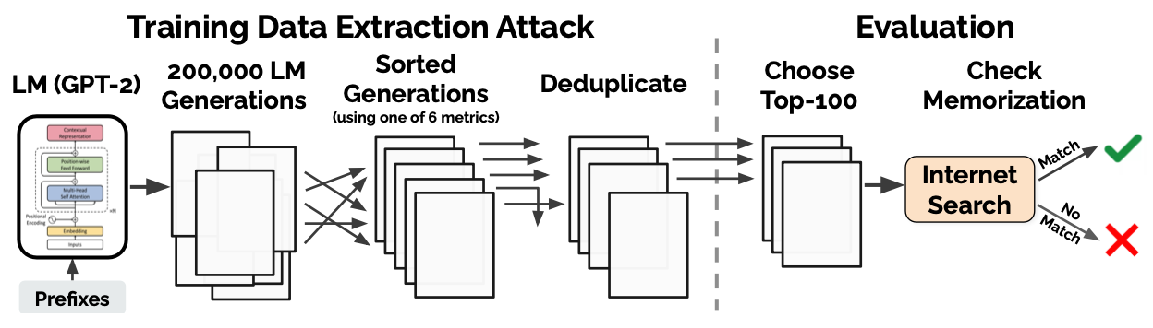
Membership Inference Attack on GPT-2
Membership Inference Attack have been shown to be successful again large language models (GPT-2)¹
Sentence completion (i.e., prompt engineering)
Sentence Likelihood
Carline et al. “Extracting Training Data from Large Language Models”, (2020)
1. Carline et al. “Extracting Training Data from Large Language Models”, (2020)

Slide 15
Data Poisoning
15

Slide 16
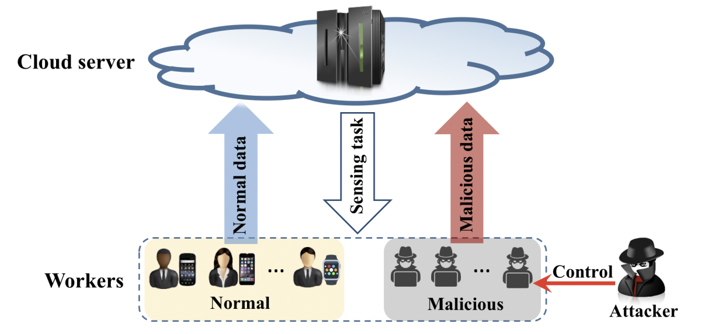
Data Poisoning
Simulated Covariate Shift through specially crafted data points that causes updated model to benefit attacker.
Can be applied to affect
Availability
Integrity (Backdoors)
Is effective to manipulate Recommender Systems¹, online learning systems and federated learning systems².
Targeted / Indiscriminate
Causative
Black-box
Availability / Integrity
Miao et al., “Towards Data Poisoning Attacks in Crowd Sensing Systems” (2018)
1. Huang, et al. "Data Poisoning Attacks to Deep Learning Based Recommender Systems" , NDSS, (2021).
2. Tolpegin, et al. “Data Poisoning Attacks Against Federated Learning Systems”, ESORICS, (2020)

Slide 17
Adversarial Attack
17

Slide 18
Backdoor Attack
18

Slide 19
01
Our company
This is the subtitle that makes it comprehensible

Slide 20
Our commitments
Commitments to science
Commitments to our clients
Mercury is the closest planet to the Sun and the smallest one in the entire Solar System
Jupiter is the biggest planet and the fourth-brightest object in the night sky

Slide 21
Our history
Jupiter is the biggest planet in the Solar System
Despite being red, Mars is a very cold place
Jupiter
Mars
2005
2008
2010
Venus
Venus is the second planet from the Sun

Slide 22
Our history
Earth is the planet where we all live
Earth
2012
2016
And still
counting!
Saturn
Saturn is a gas giant and has several rings

Slide 23
Awesome words

Slide 24
— Someone Famous
This is a quote, words full of wisdom that someone important said and can make the reader get inspired”

Slide 25
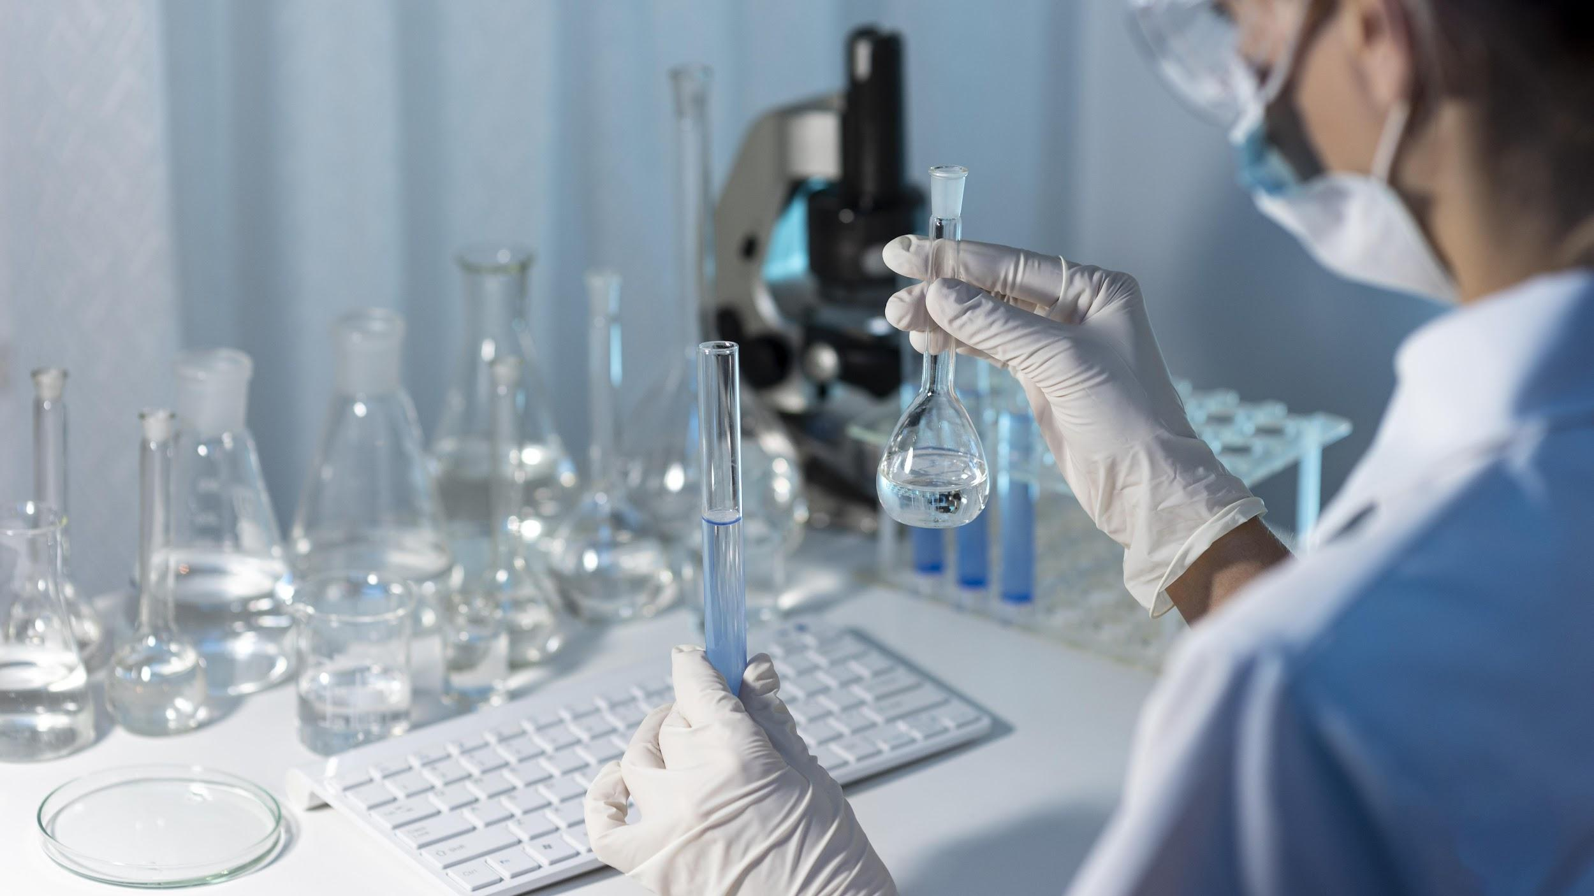
A picture is worth a thousand words

Slide 26
Our philosophy
Mision
Vision
Values
Despite being red, Mars is actually a cold place. It’s full of iron oxide dust
Jupiter is the biggest planet in the Solar System and it’s also a gas giant
Mercury is the closest planet to the Sun and the smallest one in the Solar System

Slide 27
13,102,019
Big numbers can catch your audience’s attention

Slide 28
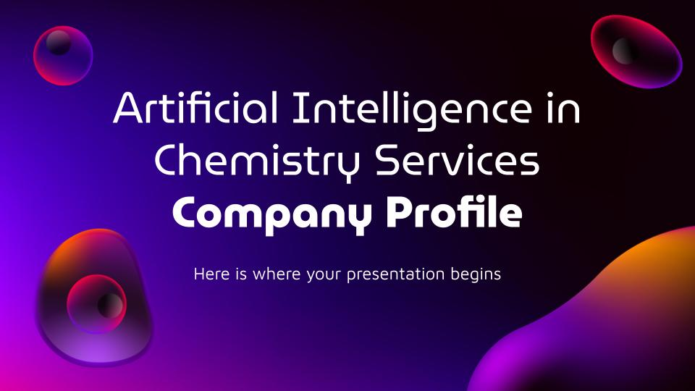
Our website
You can replace the image of the screen with your own work. Just delete this one, add yours and center it properly

Slide 29
Our objectives
Objective | Progress | Deadline
Mercury |  | 04/2022
Mars |  | 06/2022
Jupiter |  | 10/2022
Venus |  | 12/2022
90%
64%
50 %
30%

Slide 30
Locations
Mercury
It’s the closest planet to the Sun
Venus
It’s the second planet from the Sun
Saturn
Saturn is a gas giant and has rings

Slide 31
Our services
Saturn
Neptune
Jupiter
Venus
Mars
Mercury
Saturn is a gas giant and has several rings
Neptune is the farthest planet from the Sun
Jupiter is the biggest planet in the Solar System
Venus is the second planet from the Sun
Despite being red, Mars is a cold place not hot
Mercury is the closest planet to the Sun

Slide 32
Best sellers
Mercury is the closest planet to
the Sun
Neptune is the farthest planet from the Sun
Despite being red, Mars is actually a cold place
01
02
03

Slide 33
Our strengths
Loyalty
Efficiency
Reliability
Commitment
Neptune is the farthest planet from the Sun
Mercury is the closest planet to the Sun
Jupiter is the biggest planet of them all
Despite being red, Mars is a cold place not hot

Slide 34
333,000
9h 55m 23s
386,000 km
The Sun’s mass compared to Earth’s
Jupiter’s rotation period
Distance between Earth and the Moon

Slide 35
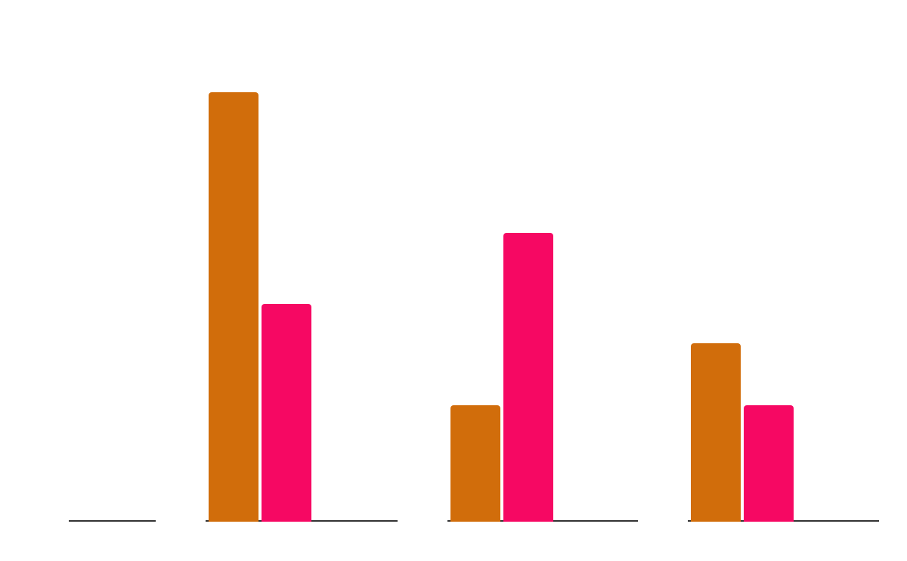
Our growth
Mercury
It’s the closest planet to the Sun
Venus
It’s the second planet from the Sun
Mars
2019
2020
2021
Mars is actually a very cold place
Follow the link in the graph to modify its data and then paste the new one here. For more info, click here

Slide 36
Customer profile
Gender
Age
18 - 35
80%
36 - 60
25%
25%
75%
Interests
25%
50%
90%
Mercury is the smallest planet
Mars is actually a cold place
Venus has a beautiful name

Slide 37
Our numbers
Budget
80%
50%
70%
Sales
People
Market
Neptune is far away from us
Mars is a really cold place
Jupiter is the biggest planet
$28.87
30 days
45 labs
77 units
Avg. price per unit
Avg. days on market
Retailers
Remaining inventory

Slide 38
Future projects
Venus is the second planet from the Sun
Mercury is the closest planet to the Sun
Project 1
Project 3
01
02
03
04
Project 2
Project 4
Despite being red, Mars is a very cold place
Jupiter is a gas giant and the biggest planet

Slide 39
Customers testimonials
Jane Thorne
James Jones
Laura Reid
“Despite being red, Mars is a very cold place. The planet is full of iron oxide dust”
“Mercury is the closest planet to the Sun and the smallest one in the Solar System”
“Venus has a beautiful name and is the second planet from the Sun. It’s terribly hot”

Slide 40
Awards
Venus
Mars
Mercury
Saturn
Neptune
Venus is the second planet from the Sun. It’s really hot there
Despite being red, Mars is actually a cold place, not hot
Mercury is the closest planet to the Sun and the smallest one
Saturn is a gas giant mostly composed of hydrogen and helium
Neptune is the farthest planet from the Sun

Slide 41
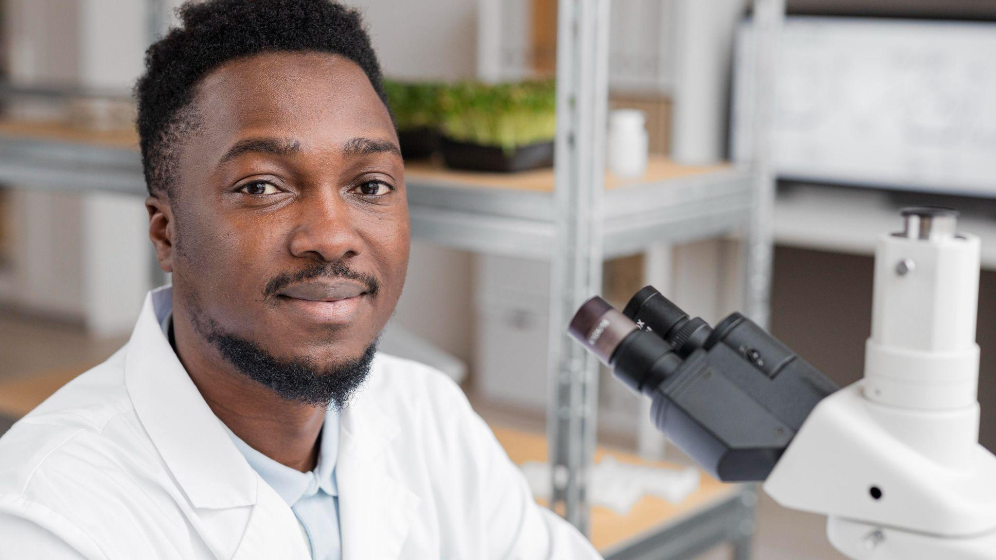
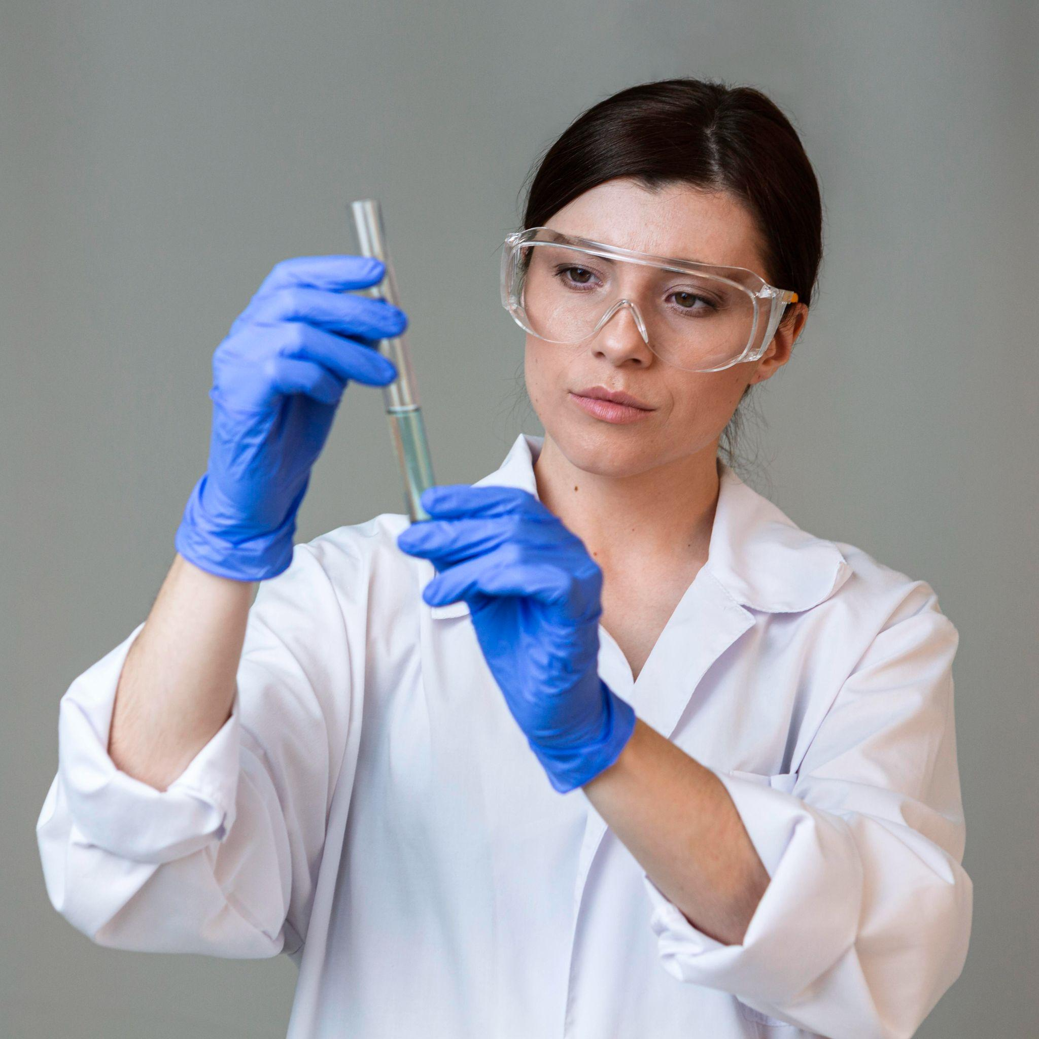
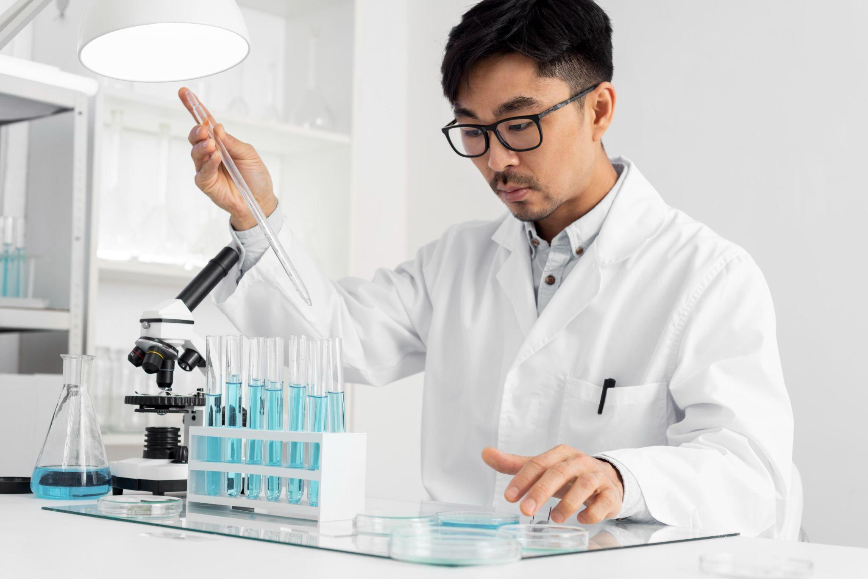
Our team
Curtis Stone
Lena Stewart
Shaun Moyes
You can replace the image on the screen with your own
You can replace the image on the screen with your own
You can replace the image on the screen with your own

Slide 42
Thanks!
Does anyone have any questions?
addyouremail@freepik.com
+91 620 421 838
yourcompany.com
Please keep this slide for attribution

Slide 43





Alternative resources

Slide 44
Alternative resources
Photos:
Close up blurry researcher holding glassware
Front view of female researcher with safety glasses and test tube
Man in lab doing experiments
Man researcher in the laboratory
Vectors:
Gradient background in futuristic style

Slide 45
Resources
Photos:
Close up researcher holding glassware
Front view of female researcher with safety glasses and test tube
Portrait man in lab working or microscope
Smiley man researcher in the laboratory using microscope
Vectors:
Gradient background in futuristic style

Slide 46
Instructions for use
In order to use this template, you must credit Slidesgo by keeping the Thanks slide.
You are allowed to:
- Modify this template.
- Use it for both personal and commercial projects.
You are not allowed to:
- Sublicense, sell or rent any of Slidesgo Content (or a modified version of Slidesgo Content).
- Distribute Slidesgo Content unless it has been expressly authorized by Slidesgo.
- Include Slidesgo Content in an online or offline database or file.
- Offer Slidesgo templates (or modified versions of Slidesgo templates) for download.
- Acquire the copyright of Slidesgo Content.
For more information about editing slides, please read our FAQs or visit Slidesgo School:
https://slidesgo.com/faqs and https://slidesgo.com/slidesgo-school

Slide 47
Instructions for use (premium users)
In order to use this template, you must be a Premium user on Slidesgo.
You are allowed to:
Modify this template.
Use it for both personal and commercial purposes.
Hide or delete the “Thanks” slide and the mention to Slidesgo in the credits.
Share this template in an editable format with people who are not part of your team.
You are not allowed to:
Sublicense, sell or rent this Slidesgo Template (or a modified version of this Slidesgo Template).
Distribute this Slidesgo Template (or a modified version of this Slidesgo Template) or include it in a database or in any other product or service that offers downloadable images, icons or presentations that may be subject to distribution or resale.
Use any of the elements that are part of this Slidesgo Template in an isolated and separated way from this Template.
Register any of the elements that are part of this template as a trademark or logo, or register it as a work in an intellectual property registry or similar.
For more information about editing slides, please read our FAQs or visit Slidesgo School:
https://slidesgo.com/faqs and https://slidesgo.com/slidesgo-school

Slide 48
Fonts & colors used
This presentation has been made using the following fonts:
MuseoModerno
(https://fonts.google.com/specimen/MuseoModerno)
Maven Pro
(https://fonts.google.com/specimen/Maven+Pro)
#000000
#ffffff
#f60863
#11000b
#41046c
#d16d0b

Slide 49





Storyset
Create your Story with our illustrated concepts. Choose the style you like the most, edit its colors, pick the background and layers you want to show and bring them to life with the animator panel! It will boost your presentation. Check out How it Works.
Pana
Amico
Bro
Rafiki
Cuate

Slide 50
Use our editable graphic resources...
You can easily resize these resources without losing quality. To change the color, just ungroup the resource and click on the object you want to change. Then, click on the paint bucket and select the color you want. Group the resource again when you’re done. You can also look for more infographics on Slidesgo.

Slide 53
JANUARY
FEBRUARY
MARCH
APRIL
MAY
JUNE
PHASE 1
Task 1
Task 2
PHASE 2
Task 1
Task 2
JANUARY
FEBRUARY
MARCH
APRIL
PHASE 1
Task 1
Task 2

Slide 56
...and our sets of editable icons
You can resize these icons without losing quality.
You can change the stroke and fill color; just select the icon and click on the paint bucket/pen.
In Google Slides, you can also use Flaticon’s extension, allowing you to customize and add even more icons.

Slide 57
Educational Icons
Medical Icons

Slide 58
Business Icons
Teamwork Icons

Slide 59
Help & Support Icons
Avatar Icons

Slide 60
Creative Process Icons
Performing Arts Icons

Slide 61
Nature Icons

Slide 62
SEO & Marketing Icons

Slide 63


